Slide 1
Title: Effective Office Correspondence
Group Members
Umar Iqbal (22PWCSE2122)
Mohsin Sajjad (22PWCSE2149)
Muhammad Musab (22PWCSE2201)
Submitted To
Prof. Dr. Laiq Hasan

Slide 2
What is Office Correspondence?
The exchange of written communication within or between organizations.
Essential for clear, professional communication.

Slide 3
Types of Office Correspondence
Internal (e.g., Memos)
External (e.g., Business Letters)

Slide 4
Importance of Office Correspondence
Helps work go smoothly
Avoids confusion
Shows professionalism
Keeps records of what was said

Slide 5
Basic Rules to Follow
Think before you write
Use simple language
Keep it short and focused
Always check spelling & grammar

Slide 6
Structure of a Business Letter
Sender’s Address
Date
Receiver’s Address
Subject
Salutation
Body
Complimentary Close
Signature

Slide 7
Do’s and Don’ts
✅ Be professional
✅ Use correct format
✅ Proofread before sending
❌ Don’t use slang or emojis
❌ Don’t send unclear messages
❌ Don’t ignore important replies

Slide 8
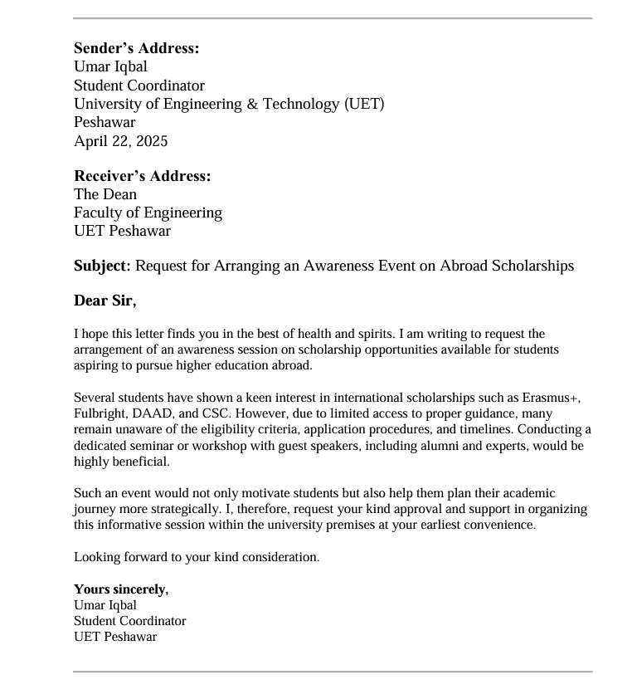
Example

Slide 9
Final Tips
Use simple and kind words
Say only what is needed
Always read before sending
Answer on time

Slide 10
THANK YOU

